Slide 1
M-F Effect Estimate Comparison
4/12/2022

Slide 2
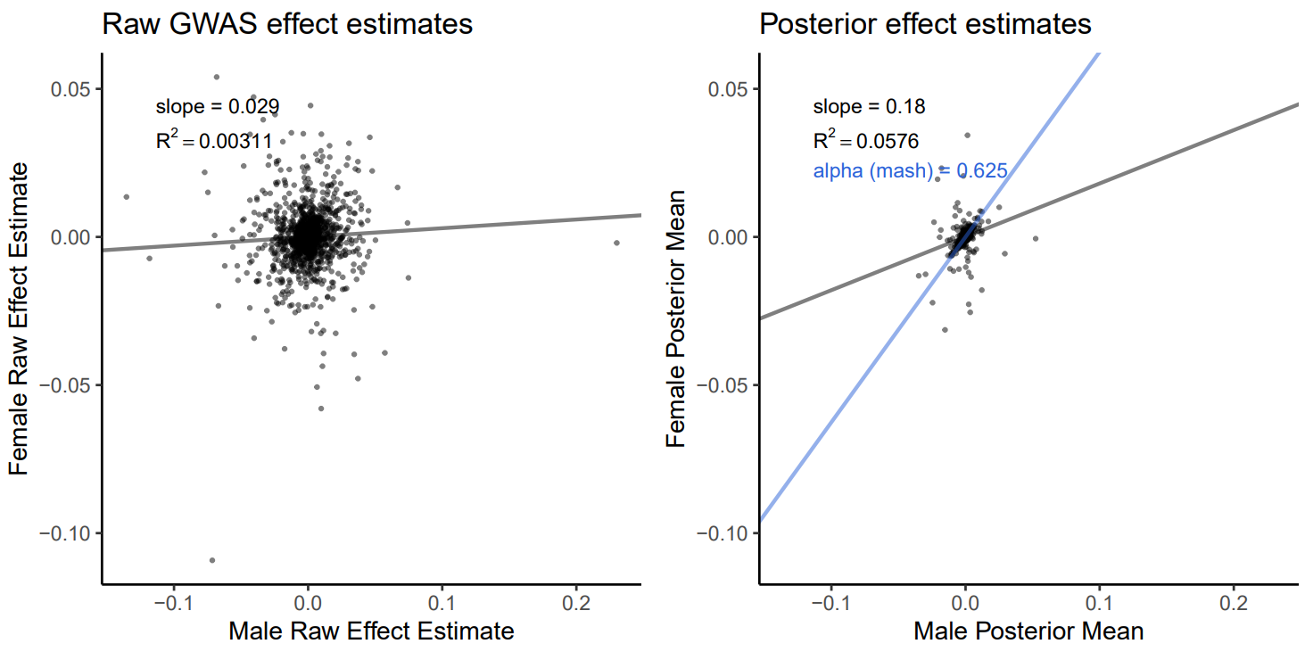
Arm fat-free mass (L)

Slide 3
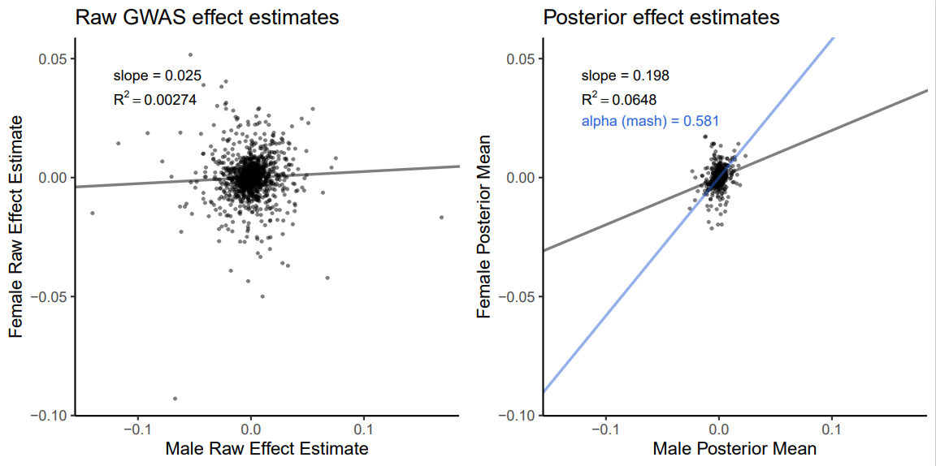
Arm fat-free mass (R)

Slide 4
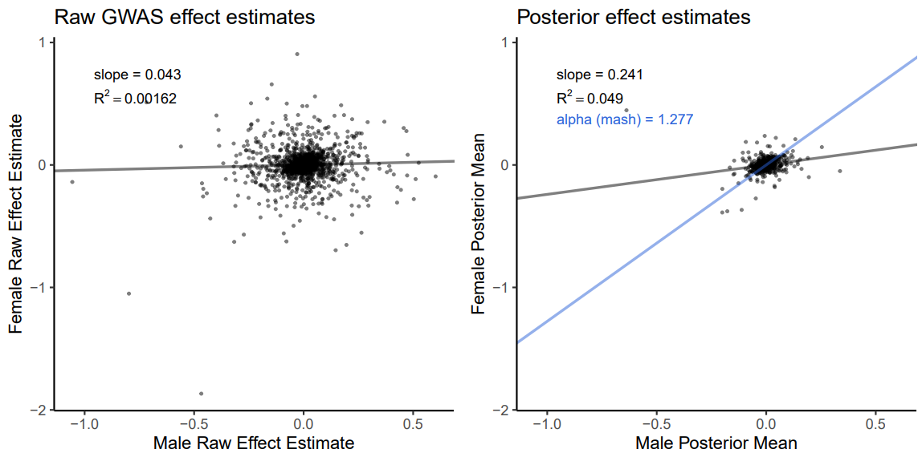
BMI

Slide 5
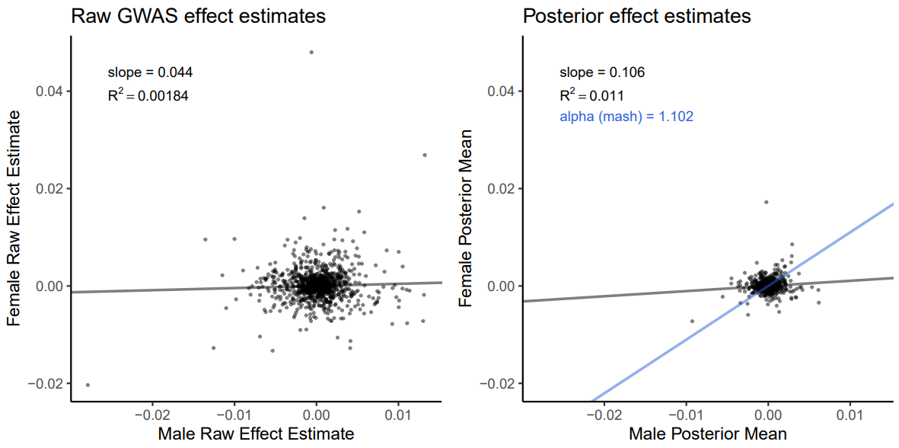
Calcium

Slide 6
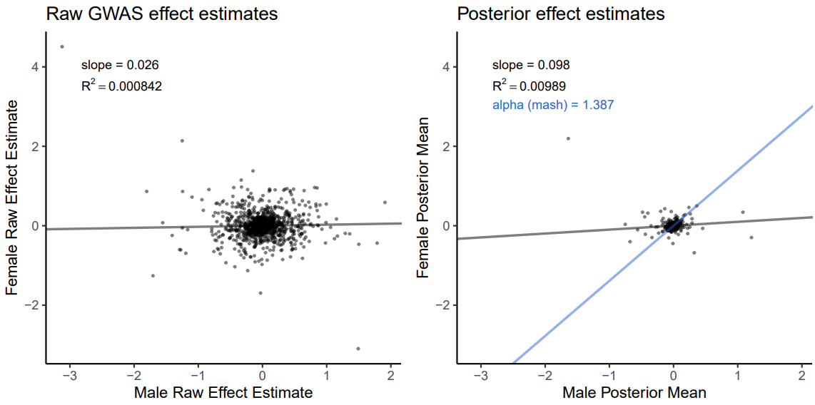
Diastolic BP

Slide 7
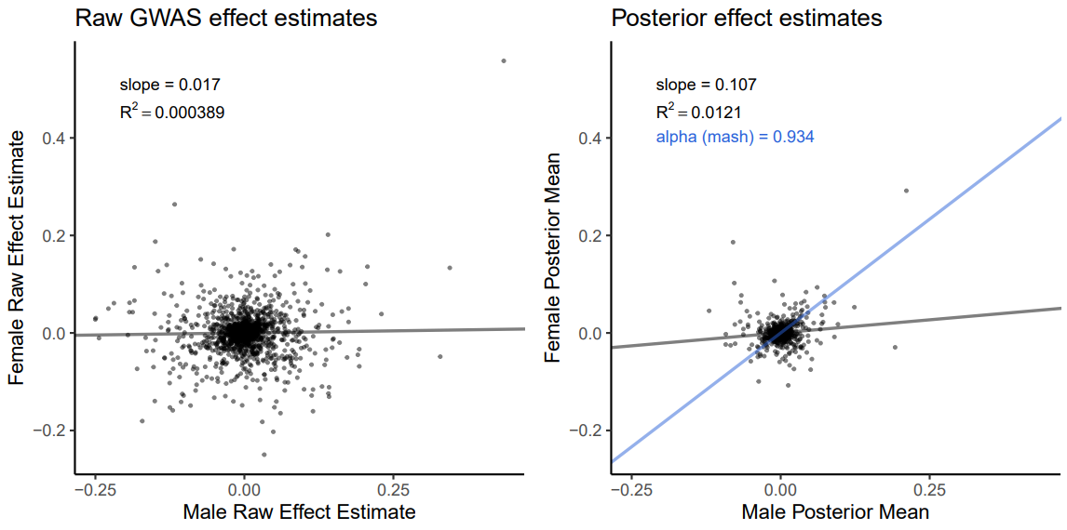
Eosinophil %

Slide 8
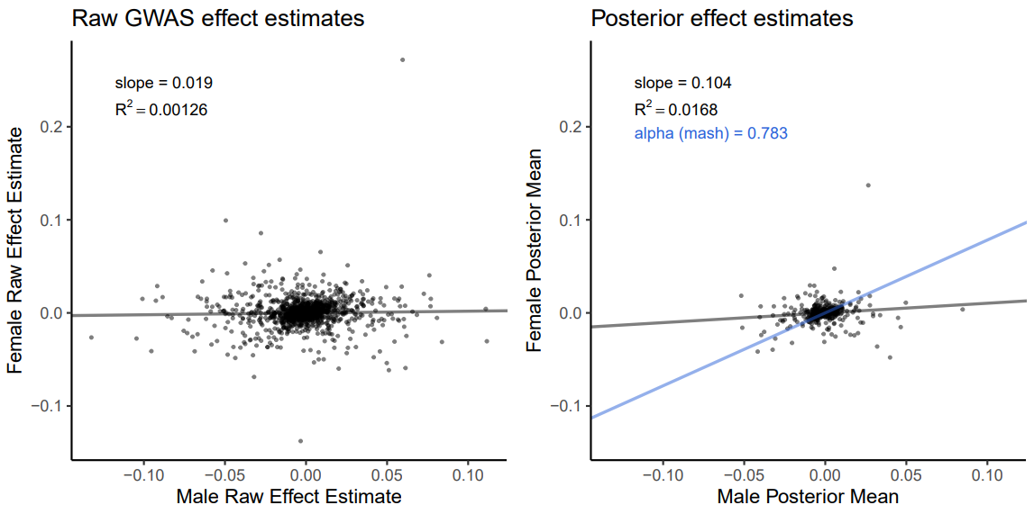
Forced vital capacity

Slide 9
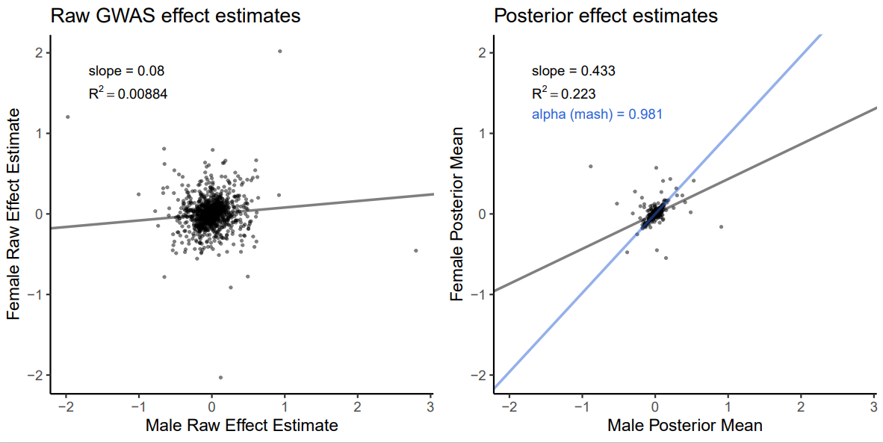
Height

Slide 10
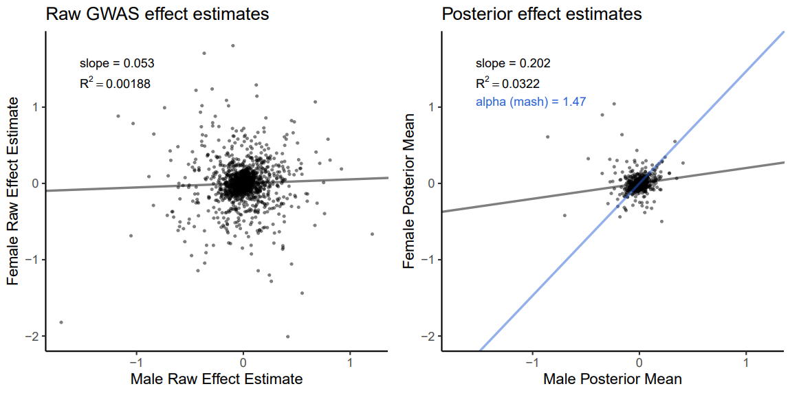
Hip circumference

Slide 11
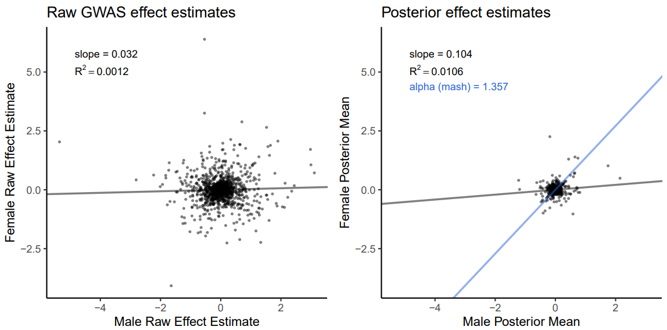
Systolic BP

Slide 12
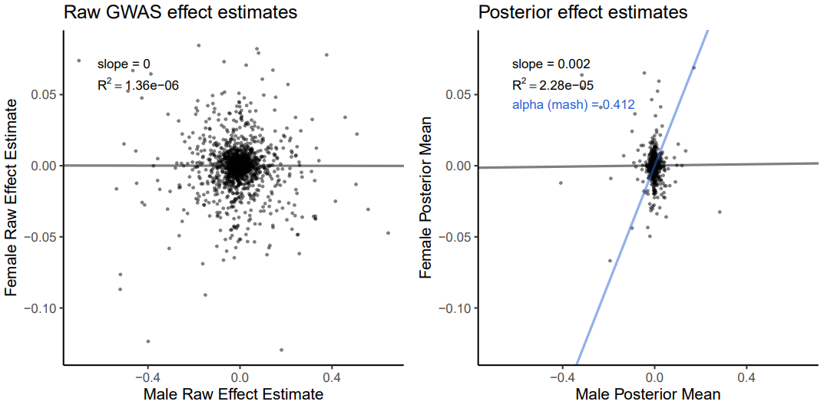
Testosterone

Slide 13
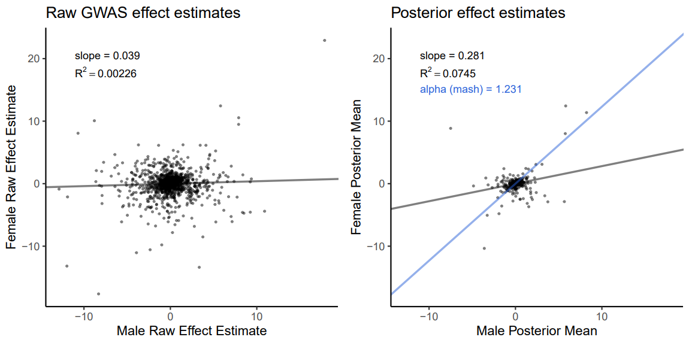
Urate

Slide 14
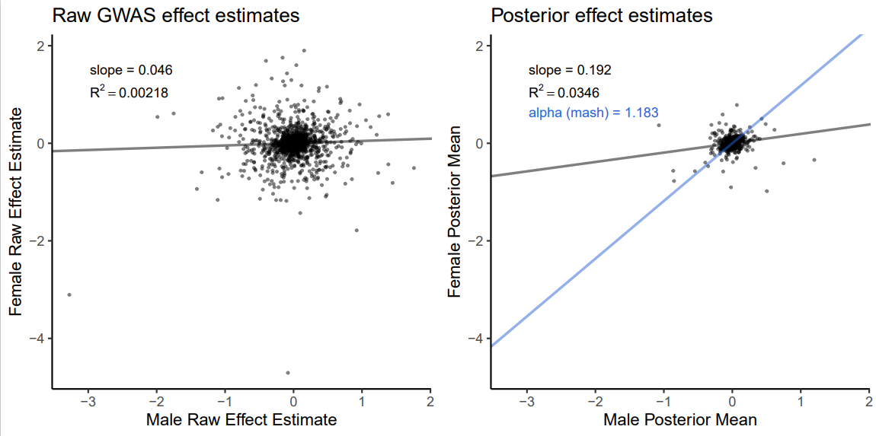
Waist circumference

Slide 15
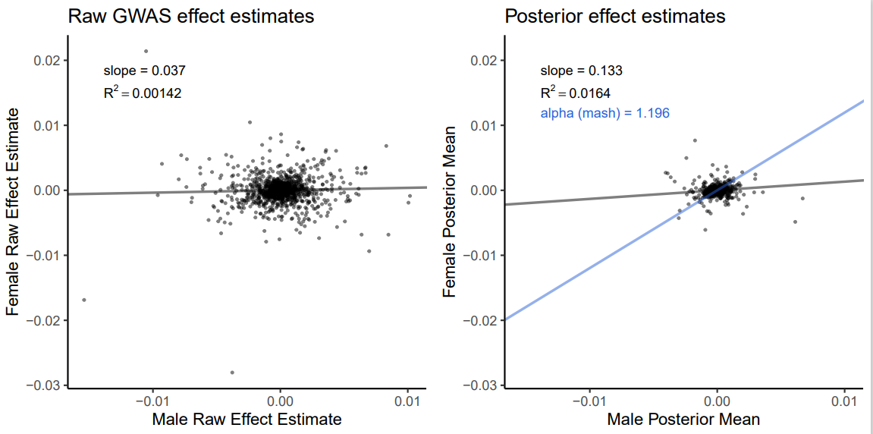
Waist to hip ratio

Slide 16
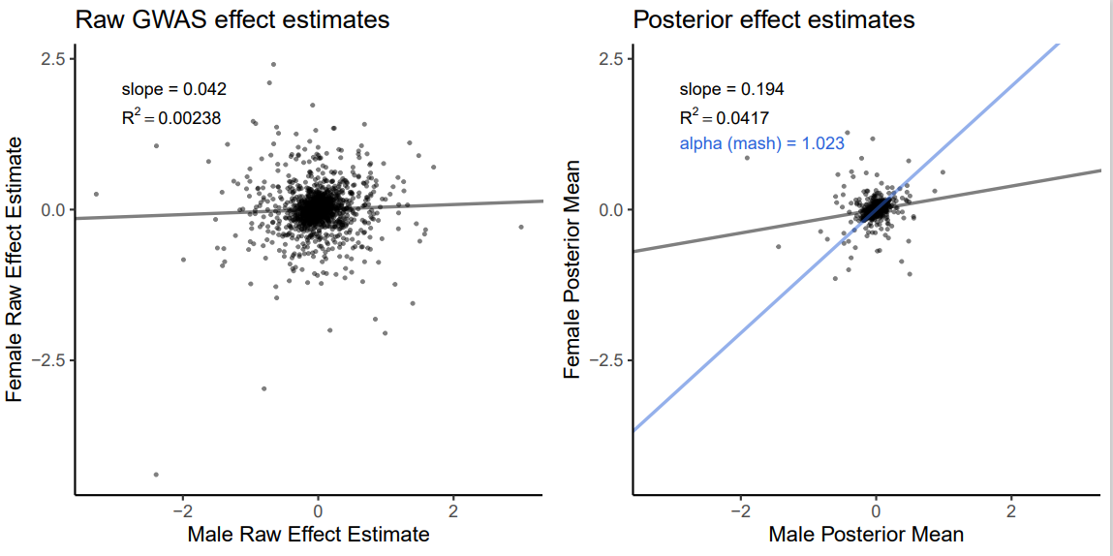
Weight

Slide 17
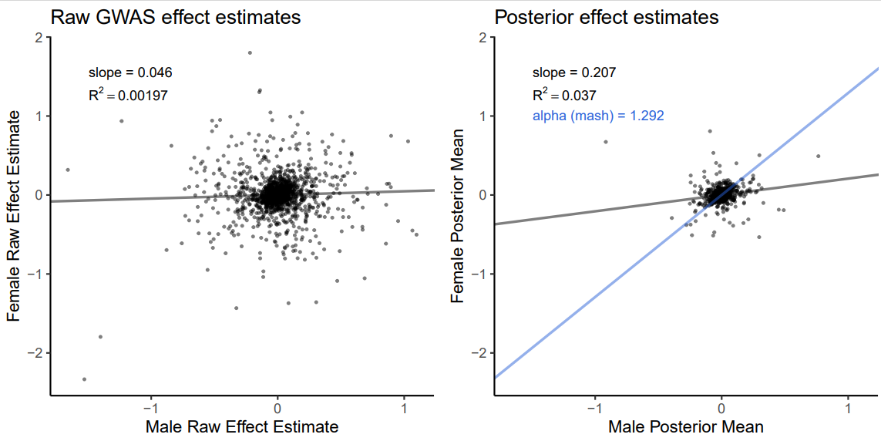
Whole body fat mass

Slide 18
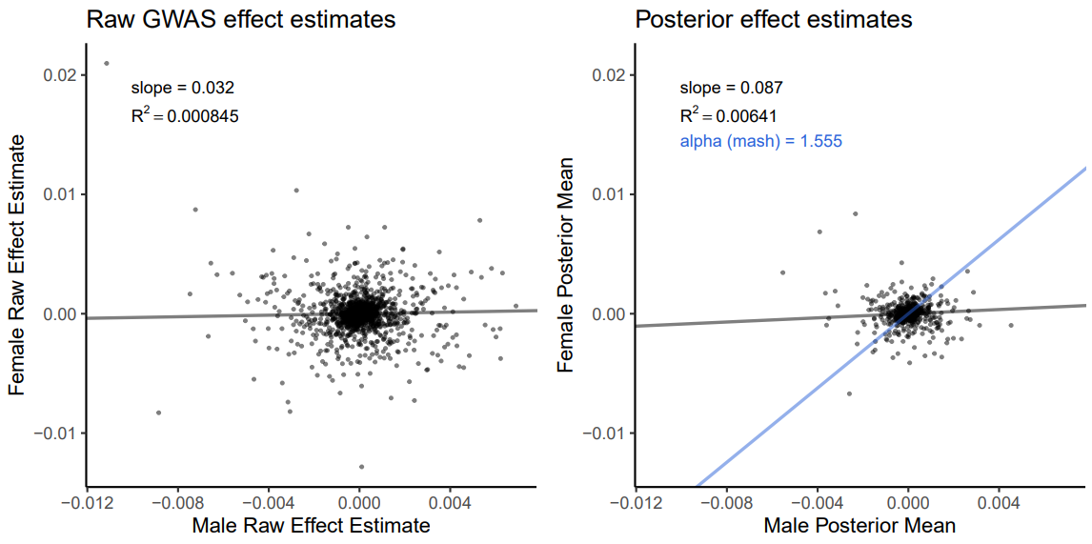
BMI adjusted waist:hip

